Slide 1


AMAZON TRANSLATOR BOT
By:
Subject :
Software Group Project-III (IT 345)
Yastee A. Shah (16IT148)
Ishan Trivedi (16IT140)
Guided By:
Mr. Sandip Patel (Assistant Professor)
Mr. Kamlesh Makwana (Assistant Professor)

Slide 2

What is Bot?
Used Services
Working Schema
Work Completed
Limitations
Uses
Benefits
Applications
Future Goals
CONTENTS

Slide 3
What is a BOT?
An internet bot, also known as web robot, WWW robot or simply bot, is a software application that runs automated tasks over the Internet.
Contents

Slide 4
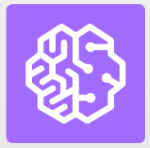
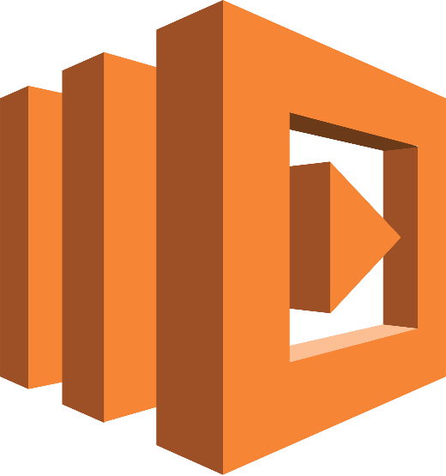



Used Services
Translate
CloudFormation
Lambda
IAM
Lex
Contents

Slide 5
Working Schema
Contents

Slide 6
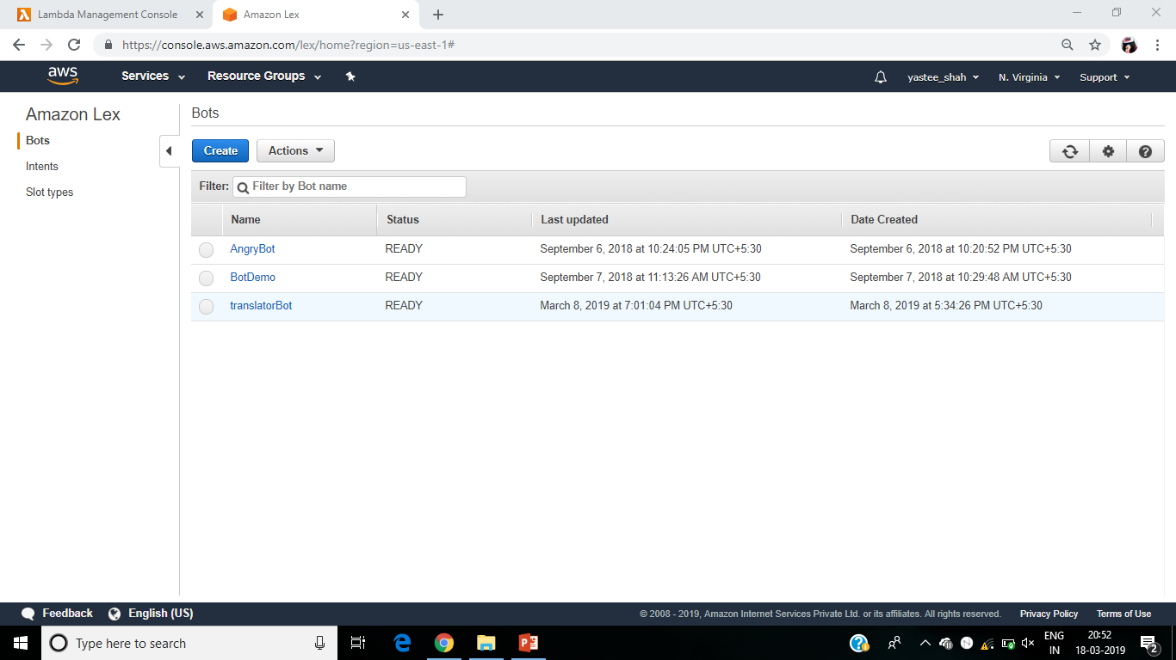
Contents

Slide 7
Working Schema
Contents

Slide 8
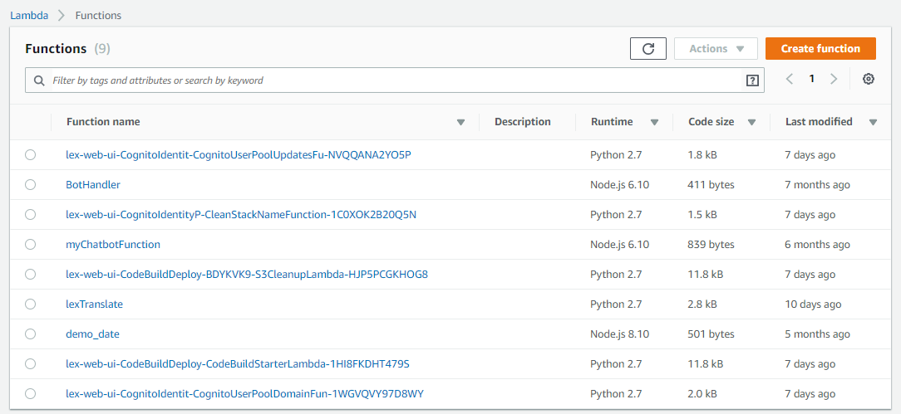
Contents

Slide 9
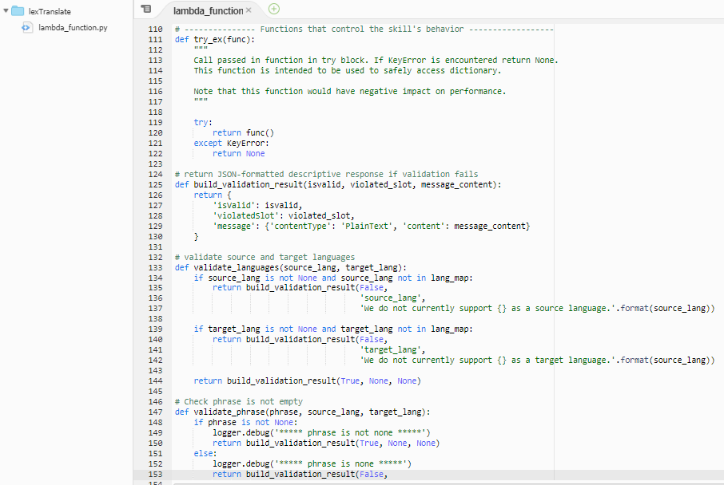
Contents

Slide 10
Working Schema
Contents

Slide 11
Working Schema
Contents

Slide 12
Working Schema
Contents

Slide 13
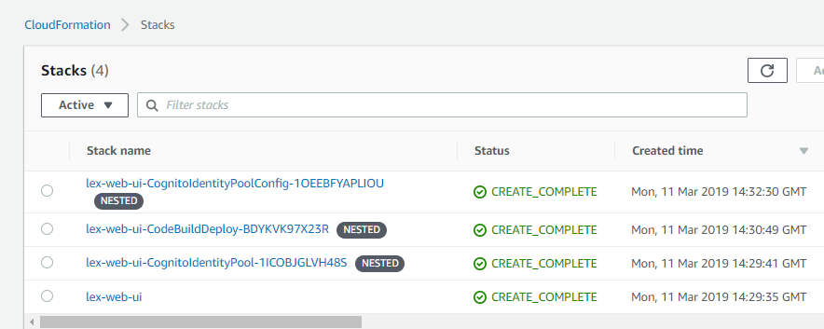
Website: https://lex-web-ui-codebuilddeploy-bdykvk97x-webappbucket-4esb3jpkohn9.s3.amazonaws.com/index.html
Contents

Slide 14
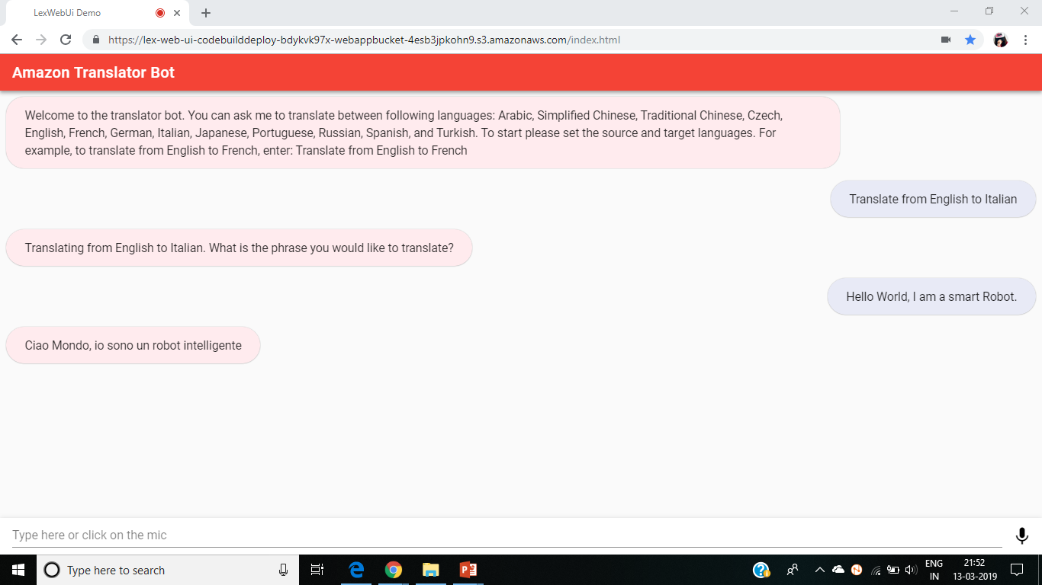


Slide 15
Contents

Slide 16
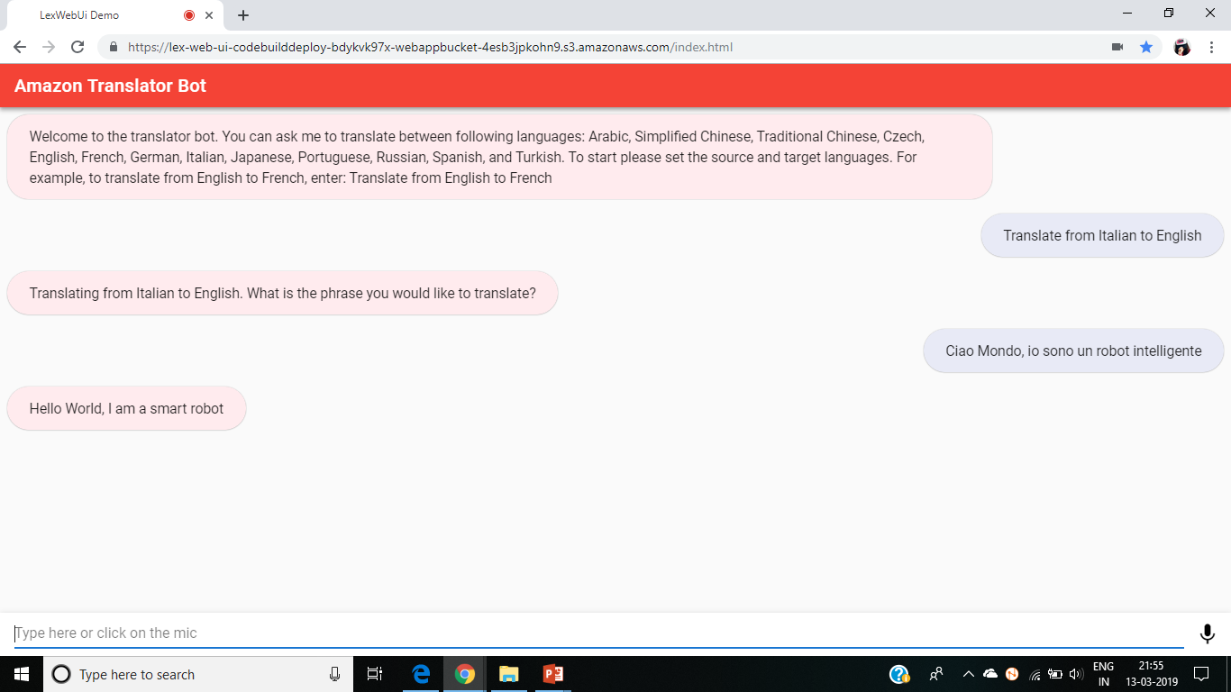
Contents

Slide 17
Work Completed
Developed the responsive Bot in AWS Management Console
Created a lambda function in AWS Management Console
Performed Cloud Formation and generated lex web URL.
Contents

Slide 18
Limitations
The accuracy of the words in the translated language.
Limit in number of languages in service.
Internet connection is required for its use.
Cannot be accessed through cellphones.
Contents

Slide 19
Benefits
Translation bots simply obtain the information needed to be fed into the actual machine translation platform.
Bots relegate the actual job of converting messages from one language to another to established machine translation platforms.
There are also bots that don’t have to be installed as an add-on but added as contacts in a messaging service.
Use for free of cost.
Contents

Slide 20
Uses
In mobile for quick and easy translation of words and sentences.
To check our accuracy in any language.
To do practice of speaking any language.
Contents

Slide 21
Applications
For self-learning.
Learning the world of Cloud with AWS.
No need for human translator.
Make conversations of foreign languages easy.
It listens to every user.
Contents

Slide 22
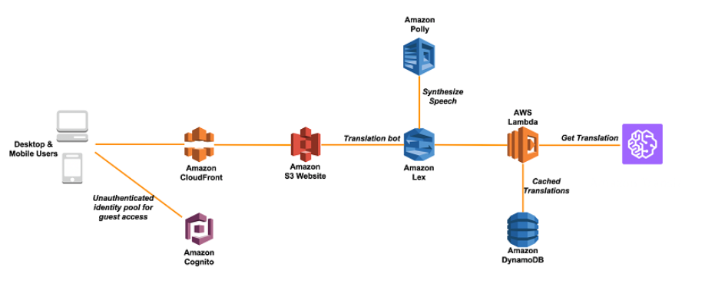
Future Goals
Contents
* https://www.pocket-lint.com/smart-home/buyers-guides/amazon/136952-amazon-echo-vs-echo-2-vs-echo-plus-vs-echo-tap-vs-echo-dot-vs-echo-show-vs-echo-spot

Slide 23
Thank You
Contents

